Slide 1

Alex Evans
@alexhevans

Slide 2
A Ratings-Based Model for Credit Risk in Maker
1. Context
2. Model Overview
3. Model Estimation
4. Risk Management Example

Slide 3
Context & Motivation

Slide 4
q_{sw}
q_{su}
Wipe
q_{uw}
Safe
Unsafe
q_{ub}
Bitten
q_{us}

Slide 5
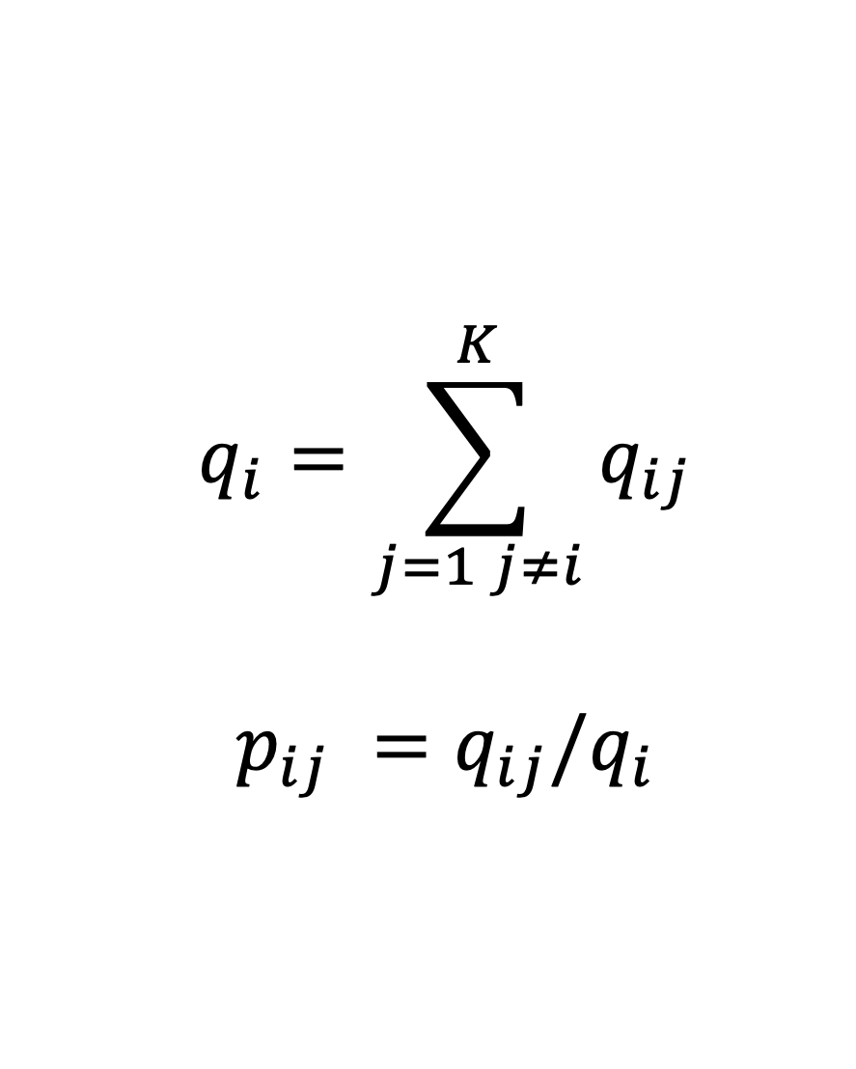
$$q_{i}=\sum_{j=1 j≠i}^{K}{q_{ij}}$$
$$p_{ij} ={q_{ij}/q}_{i}$$

Slide 6
q_{sw} q_{sb} q_{su} q_{us} q_{uw} q_{ub}

Slide 7
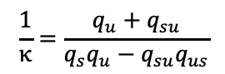
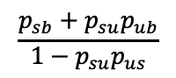
Mean Loan Lifespan
Probability Bitten
$$\frac{1}{κ}=\frac{q_{u}+q_{su}}{q_{s}q_{u}−q_{su}q_{us}}$$
$$\frac{p_{sb}+p_{su}p_{ub}}{1−p_{su}p_{us}}$$

Slide 8

S
S
S
U
S
S
S
S
W
W
W
W
U
B
S
U
S
B
S
U
B
W
S
S
S
W
S
S
S
W
S
S
S
S

Slide 9
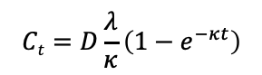
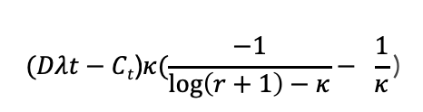
Expected Loans Outstanding
Total Stability Fees
$$(Dλt−Ct\text{)}κ(\frac{−1}{\log\left(r+1\right)−κ}− \frac{1}{κ}\text{)}$$
$$Ct=D\frac{λ}{κ}\left(1−e^{−κt}\right)$$

Slide 10
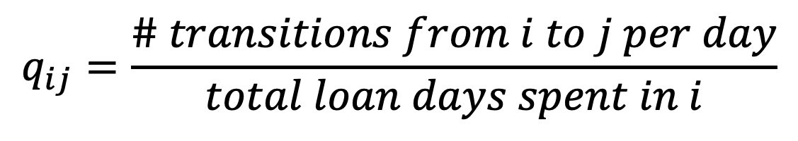
$$q_{ij}=\frac{\# transitions from i to j per day}{total loan days spent in i}$$

Slide 11
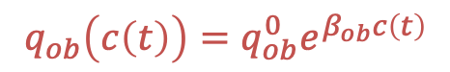
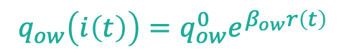
$$q_{ob}\left(c\left(t\right)\right)=q_{ob}^{0}e^{β_{ob}c\left(t\right)}$$
$$q_{ow}\left(i\left(t\right)\right)=q_{ow}^{0}e^{β_{ow}r\left(t\right)}$$
States | Baseline | Stability Fee | Coll 250-280% | Coll <250%
Open-Open | -0.010679 (-0.010808,-0.010552)
Open-Wiped | 0.008598 (0.008485, 0.008712) | 72.39 (59.76, 87.69) | 1.000 | 1.000
Open-Bitten | 0.002081 (0.002023, 0.002141) | 1.000 | 4.23 (4.022,4.448) | 14.29 (13.38, 15.26)

Slide 12
Conditional Loss Distribution

Slide 13
Alex Evans, Researcher
@alexhevans

